Slide 1
HDFS – Hadoop Distributed File System

Slide 2
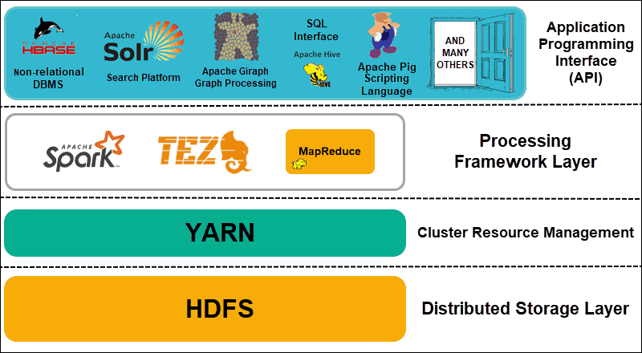
Hadoop Architecture
Distributed Storage
Hadoop Distributed File System (HDFS)
Data is split into blocks then stored in different nodes with their own resources
Master nodes keep metadata
Cluster Resource Management
Yet Another Resource Negotiator (YARN)
Coordinate nodes for data processing
Processing Framework
MapReduce, Spark
Process and analyze data
API
Various applications

Slide 3
Introduction to HDFS
A distributed file system designed to run on commodity hardware with the following features
Highly fault-tolerant
Can be deployed on low-cost hardware
High throughput that is suitable for very large datasets
Support streaming data

Slide 4

HDFS Architecture
HDFS follows a master/slave architecture with the following components
A single NameNode, a master node managing the system operations and accessibilities
A secondary NameNode as back up of the NameNode
Multiple DataNodes managing storages on nodes they are on
Data files are split into blocks stored in multiple DataNodes
NameNodes perform operations like opening, closing, renaming, moving files or directories, etc.
DataNodes serve read and write requests from clients and block operations as instructed by NameNodes

Slide 5
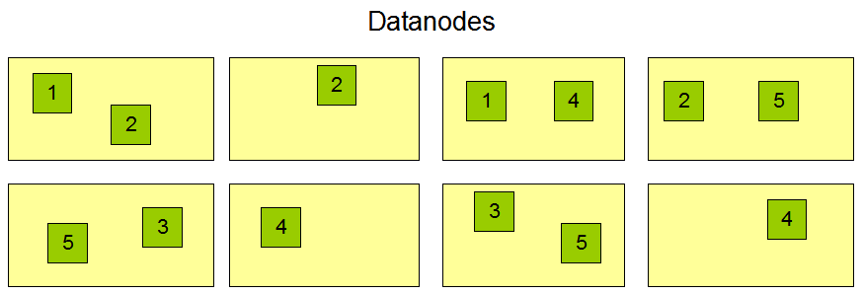
Data Replication
HDFS is designed to store very large files in a cluster
Files are split into blocks of same sizes (except the last block)
Each block is replicated in multiple DataNodes
Block sizes and replication factors are configurable (64MB and 3 by default)

Slide 6
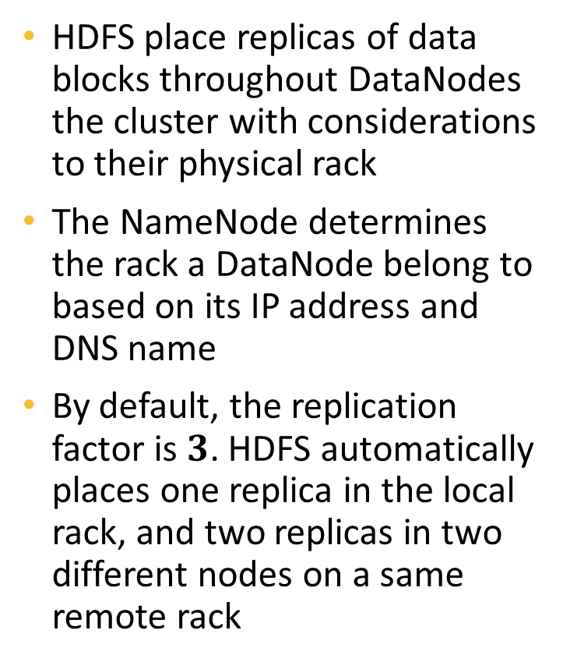
Rack-Aware Replica Placement
HDFS place replicas of data blocks throughout DataNodes the cluster with considerations to their physical rack
The NameNode determines the rack a DataNode belong to based on its IP address and DNS name
By default, the replication factor is $3$. HDFS automatically places one replica in the local rack, and two replicas in two different nodes on a same remote rack
Rack 1
Rack 2
Node 1
Node 1
Block 1
Rep. 1
Block 1
Rep. 2
Data File
Block 1
Node 2
Node 2
Block 1
Rep. 3
Block 2
Rep. 2
Block 2
Node 3
Node 3
Block 2
Rep. 1
Block 2
Rep. 3

Slide 7
HDFS Hands-on

Slide 8
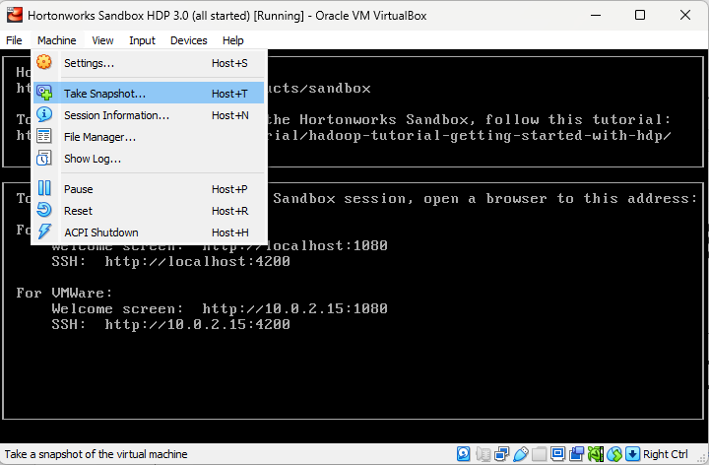
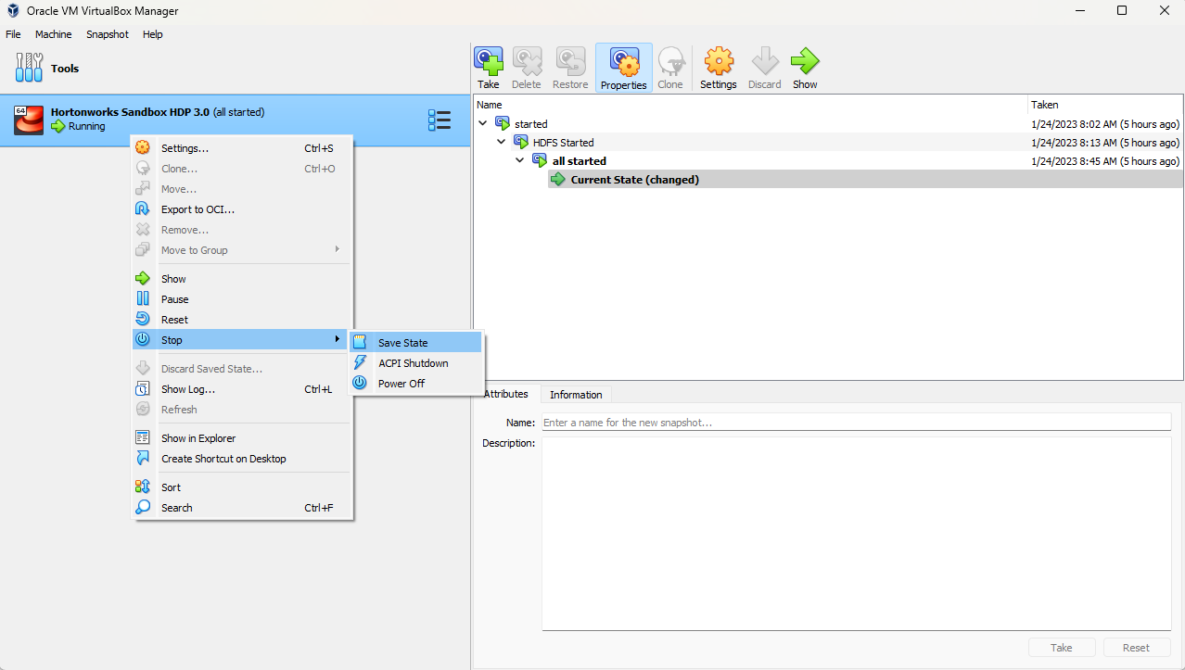
Saving Virtual Machine State
The VirtualBox Hadoop cluster may take times to start up
Instead of shutting down and resetting every session, we can save the current state of the virtual machine to continue later
Either
Take Snapshot from the VM. This allows the VM to continue running
Changes will not carry over if start from an earlier state
Also useful for backing up a VM state
OR
Stop and Save State from the VirtualBox Manager
This will stop the VM immediately

Slide 9
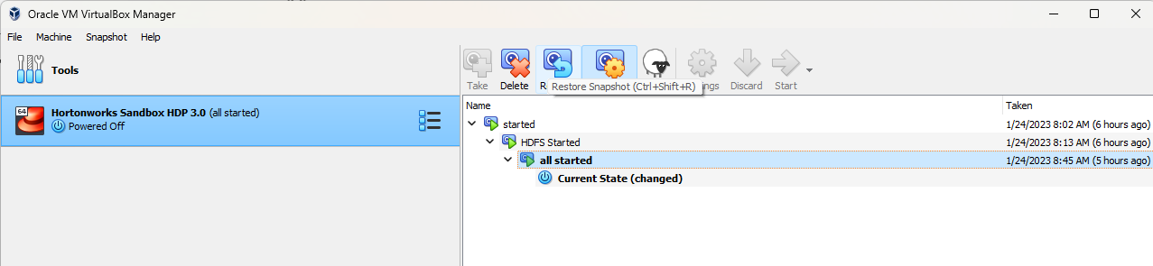
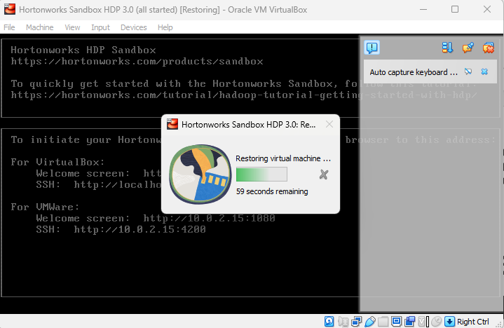
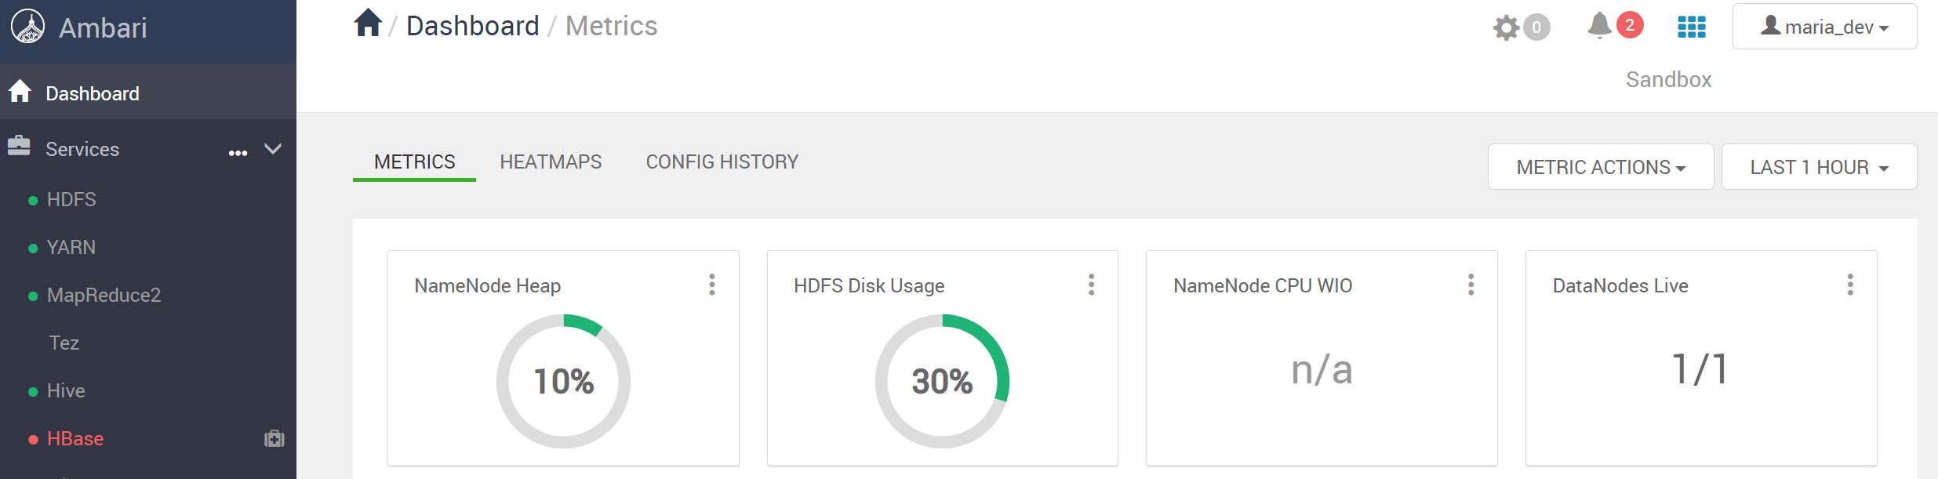
Start VM from a Saved State
While the VM is powered off, select the correct state and click on Restore
Then start the VM like normal, the restoring pop up will show
The VM will start at the save states with all services running

Slide 10
Change to HDFS View
In the Ambari sandbox, select Views then File View to change to the HDFS view

Slide 11
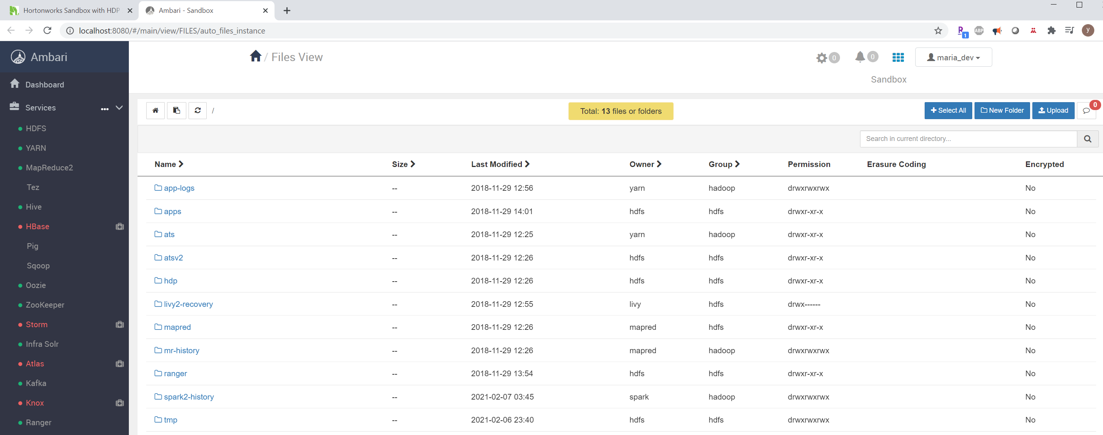
HDFS View

Slide 12
Create a New Folder
Redirect to tmp directory, then create a new folder called data

Slide 13
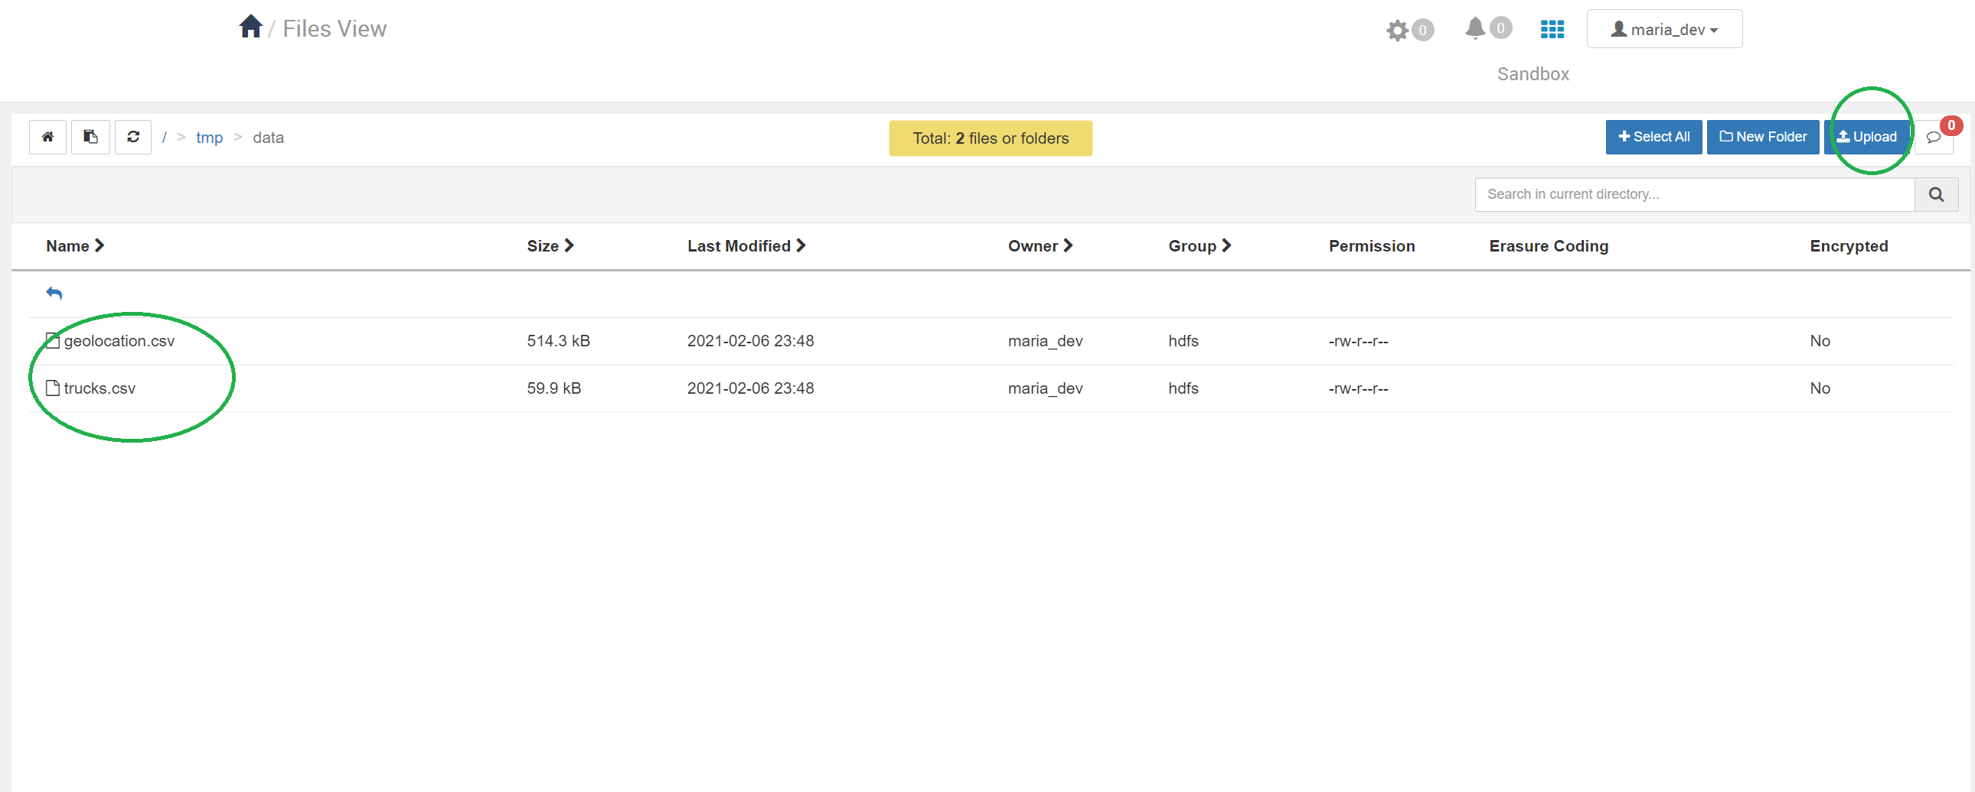
Upload Files
Upload the two files provided on D2L to the data folder

Slide 14
File Operation
When selecting a file, we will see file operations

Slide 15
Change Permission
Set permissions of the two files so that same group can also write

Slide 16
View HDFS Files from Terminal
Now go to localhost:4200 and log in using root/<your password>
Run command hadoop fs -ls to view files and folders in the current directory

Slide 17
View Contents in Specific Directory
Add the path to the directory after ls to view its contents

Slide 18
Extra Reading
https://hadoop.apache.org/docs/r1.2.1/hdfs_design.html
https://www.simplilearn.com/tutorials/hadoop-tutorial/hdfs
https://www.tutorialspoint.com/hadoop/hadoop_hdfs_overview.htm

Slide 19
Assignment 2
Please start the Hadoop HDFS system, then upload the two files (on D2L) there, finally, submit screenshots similar to slide 13 and 17

